Slide 1






Iced Tea Coffee Problem

Slide 2



Group Members
Rafia Noor Nithin
ID:2022-2-60-120
Fahimah Karim Oishi
ID:2022-2-60-134
Sanjana Kazi Supti
ID:2022-2-60-036

Slide 3

Table of contents
01
02
03
Introduction
Objective
Solution Approach
04
05
Implementation
Output
Conclusion

Slide 4

Introduction
Problem Statement:
The "Iced Tea Coffee Problem" simulates a lively conversation between two friends at a coffee shop, ensuring smooth communication and minimizing interruptions. Using semaphores, threads, and processes, the program enforces a turn-taking mechanism, allowing only one person to speak at a time. The program automatically corrects these mistakes, keeping track of the number of errors detected and corrected. This project showcases effective synchronization techniques and error handling in concurrent programming.

Slide 5
Objective
Simulate Conversation
Detect and Correct Errors
Implement Turn-Taking
Showcase Synchronization

Slide 6
Solution Approach
The solution uses a multi-threaded approach with semaphores to manage turn-taking between two friends. Each person speaks in turn, and the program checks for the phrase "iced tea," replacing it with "iced coffee" to correct errors in real-time. Shared data structures log the conversation and count corrections, ensuring orderly communication and minimizing misunderstandings. This technique effectively simulates a realistic dialogue while demonstrating efficient concurrency in C.
Use of Semaphores:
Semaphores (person1_turn and person2_turn) control the flow of the conversation, ensuring that only one person speaks at a time. Initially, Person 1 can speak while Person 2 waits.
Thread Creation:
Two threads represent the two friends. Each thread runs a loop allowing that person to speak, read input, and process the message.
Message Input and Correction:
When either person speaks, their input is taken. The program checks if the message contains "iced tea". If it does, the program replaces it with "iced coffee" using the replace_iced_tea function.

Slide 7
Turn-Taking Mechanism:
After one person finishes speaking, they post to the semaphore that allows the other person to take their turn. This maintains a controlled sequence.
Conversation Logging:
Each message is logged in a shared array (conversation), and counters for corrections and occurrences of "iced tea" are maintained.
Termination:
The conversation can end when either person types "Bye.", which sets a flag to stop the conversation and allows the other person to finish.
Output:
After both threads finish, the program prints the entire corrected conversation and the total number of corrections made.

Slide 8
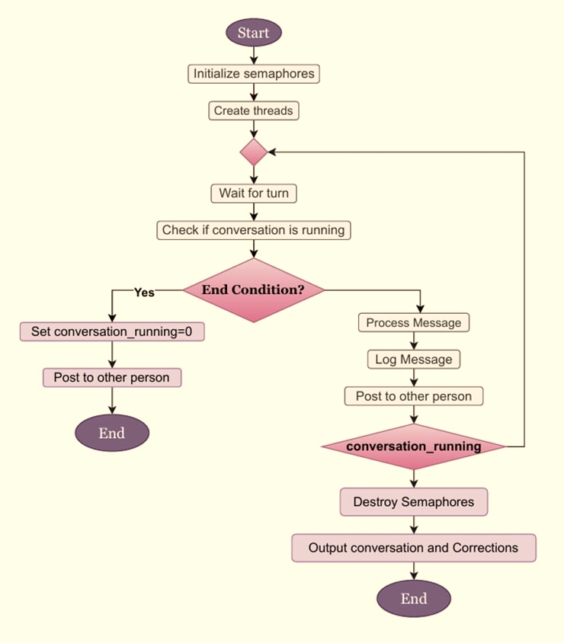
Implementation
We will illustrate the code implementation using a flowchart-

Slide 9
Flowchart Steps:
1.Start
The program begins execution, and two threads are initialized, one for each person.
2.Initialize Semaphores
person1_turn: Initially set to 1, allowing Person 1 to start the conversation.
person2_turn: Initially set to 0, meaning Person 2 has to wait for Person 1.
3.Create Threads
Thread t1 for Person 1.
Thread t2 for Person 2.
4.Wait for Turn
Each thread waits for its turn to speak using sem_wait().
Person 1 waits for their turn based on person1_turn.
Person 2 waits for their turn based on person2_turn.
5.Check if Conversation is Running:
The conversation_running flag is checked. If set to 0, the conversation ends.

Slide 10
6.End Condition:
If the message is "Bye.":
Set conversation_running = 0.
Allow the other thread to exit.
7.Process Message:
Detect "iced tea" and replace with "iced coffee".
Count corrections and occurrences.
8.Log Message:
Prefix with "Person 1: " or "Person 2: ".
Log to conversation[].
9.Post to Other Person:
Person 1 signals person2_turn and vice versa.
10.Check conversation_running:
Loop continues until conversation_running = 0.
11.Destroy Semaphores:
Clean up the semaphores after conversation ends.
12.Output Conversation and Corrections:
Print the conversation log and correction count.
13.End: Program terminates.

Slide 11
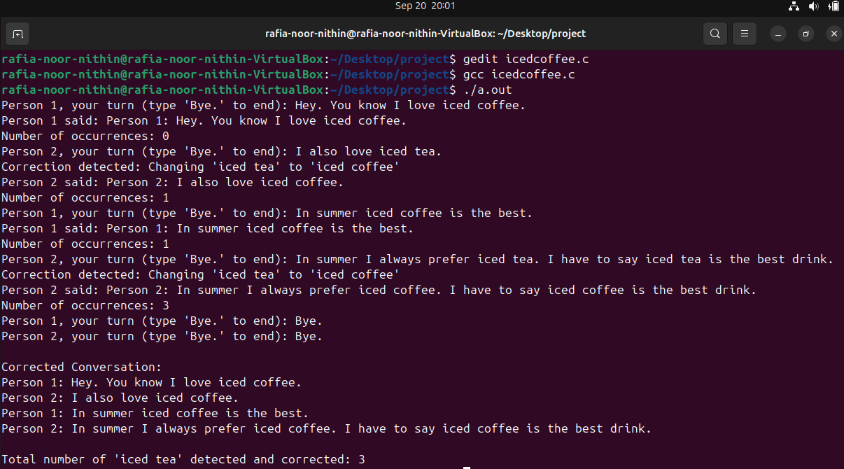
Sample Output Of The Solution:

Slide 12
Output Explanation:
Initial Conversation:
Person 1: "Hey. You know I love iced coffee."
Person 2: "I also love iced tea." (Corrected to "iced coffee")
Turn-Taking & Corrections:
Detected and corrected instances of "iced tea" to "iced coffee."
Summary:
Total corrections: 3 occurrences
Final Conversation:
Person 1: "Hey. You know I love iced coffee."
Person 2: "I also love iced coffee."
Person 1: "In summer iced coffee is the best."
Person 2: "In summer I always prefer iced coffee."

Slide 13
Conclusion
Effective Communication: Successfully simulated a structured conversation between two friends using semaphores and threads.
Turn-Taking Mechanism: Ensured only one person spoke at a time, reducing confusion and frustration.
Error Detection & Correction: Automatically corrected "iced tea" to "iced coffee," enhancing clarity in the dialogue.
Tracking Corrections: Logged the number of errors corrected, demonstrating real-time error handling.
Key Takeaway: Structured dialogue prevents misunderstandings and promotes efficient communication.

Slide 14


Slide 15


